Slide 1
Website Recommendation System
Group Members:
Manan Satra
Mohit Bhagchandani
Kriti Ruhela
Namita Powar
Rupal Desai

Slide 2
Basic idea?
We often are confused from where to purchase a product online, aren't we? Our project revolves around solving this issue
As the name suggest, it is a website recommendation system and recommends the end user the best website to purchase a product from

Slide 3
Motivation
Reduces burden of comparison
Helps resolve confusion
Helps users naïve decision making

Slide 4
Data Source
www.amazon.com
www.bestbuy.com
Since these are the two giants involved in digital market we choose these two websites as our data source.
We use Beautiful Soup for extraction of data

Slide 5
Flow of the project
Data Extraction
Data Cleaning and Preprocessing
Sentiment Analysis
Manual Labelling
Classification
Generating Results
Result Interpretation

Slide 6
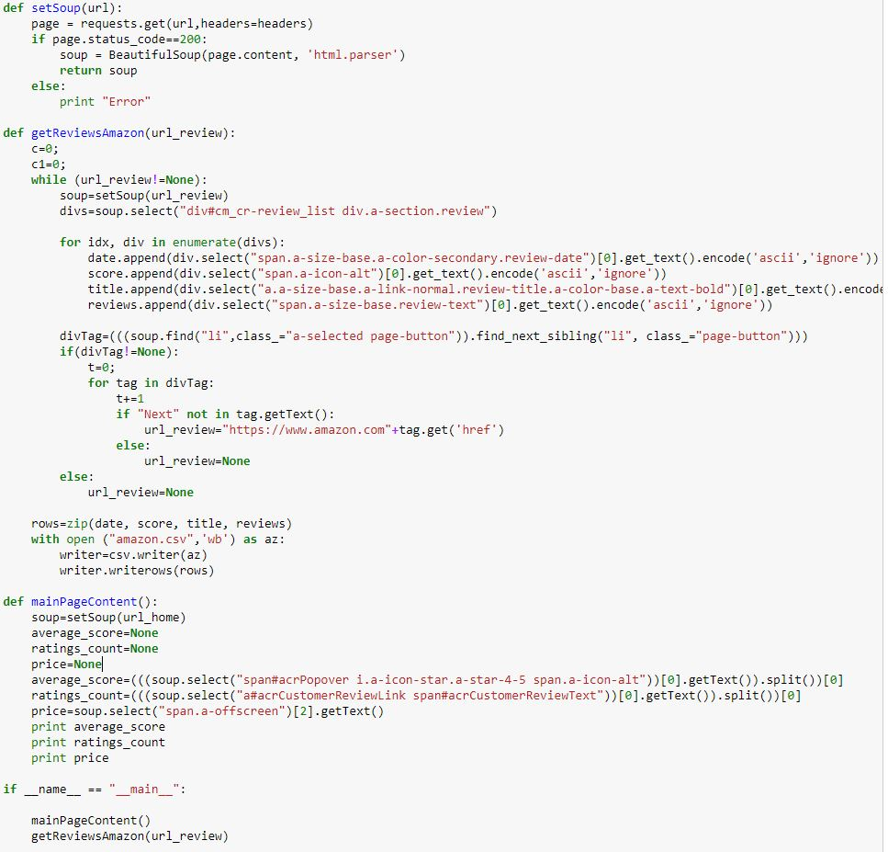
Data Extraction

Slide 7
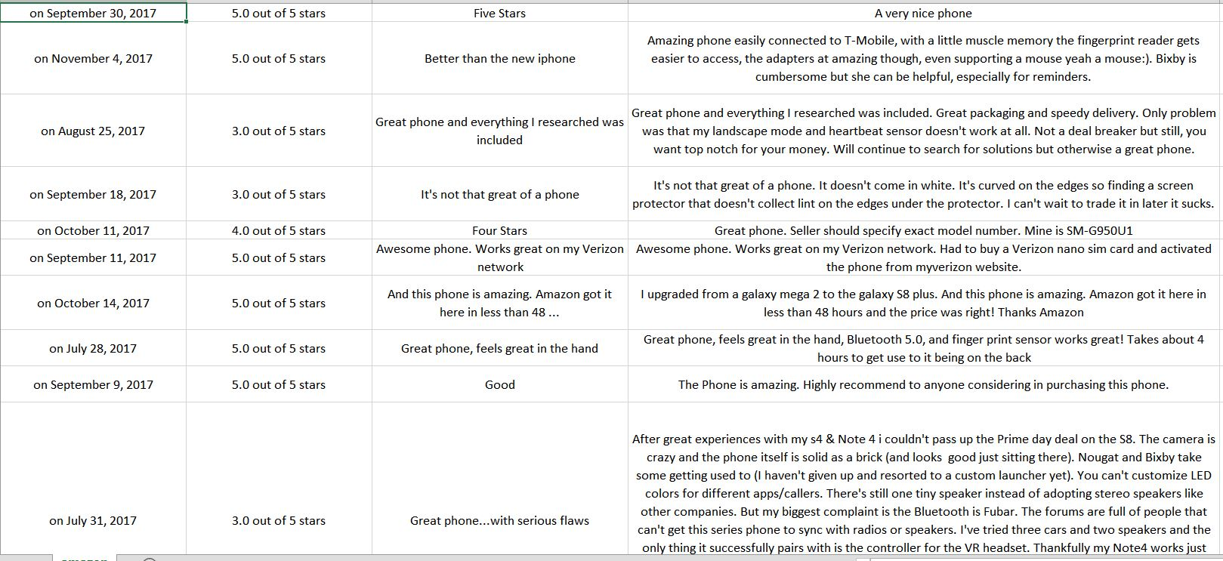

Slide 8
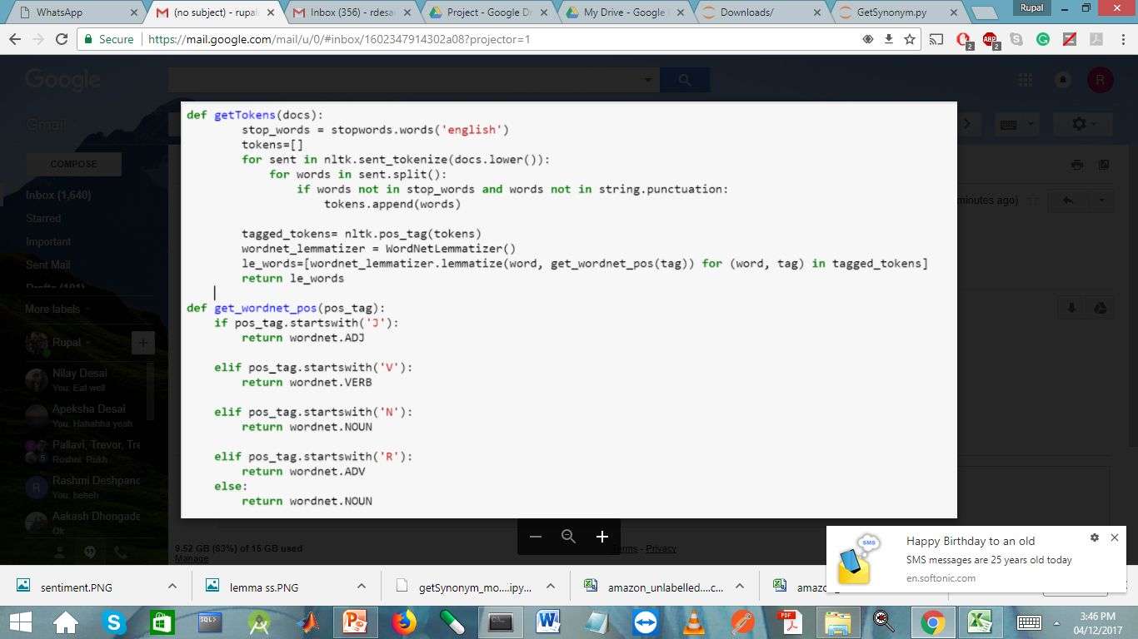
DATA CLEANING AND PREPROCESSING

Slide 9
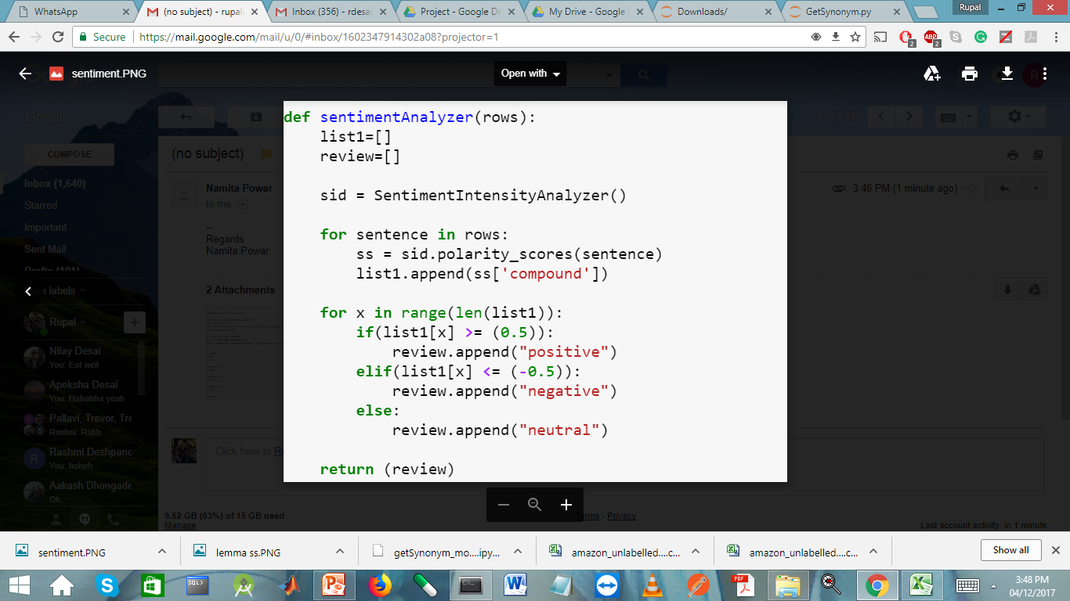
SENTIMENT analysis

Slide 10
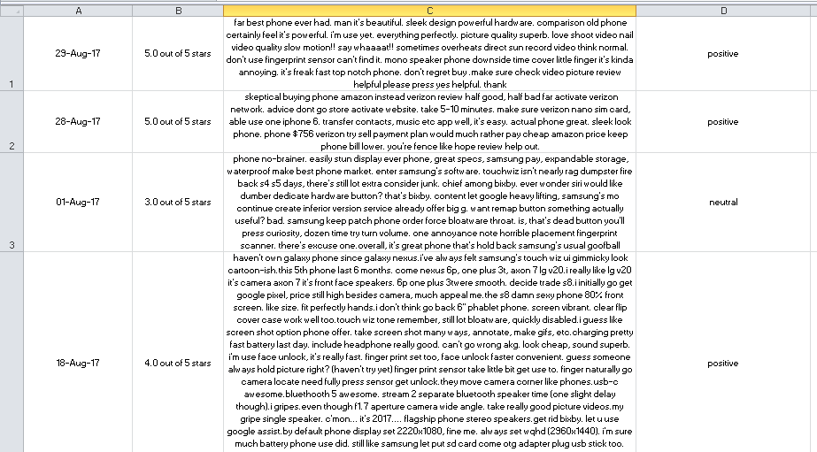

Slide 11
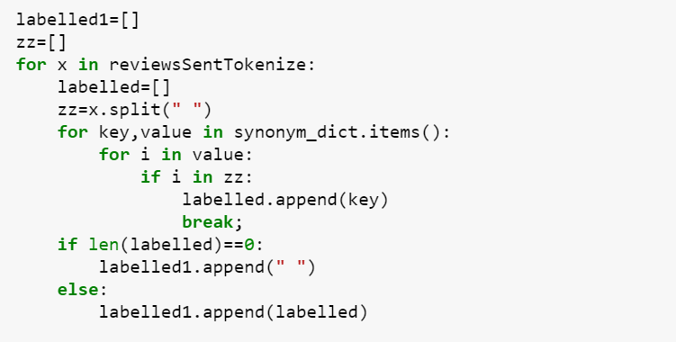
MANUAL LABELLING

Slide 12
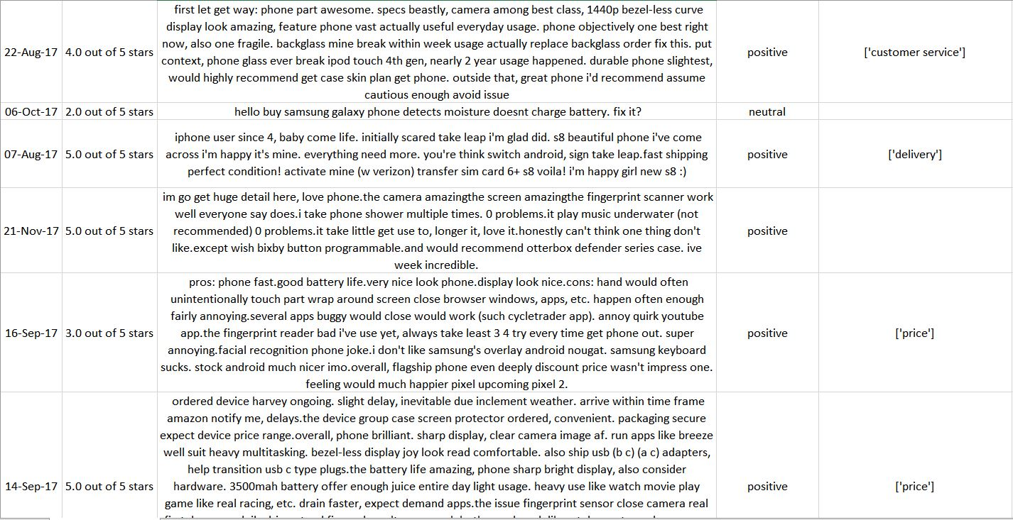
Manual labelling

Slide 13
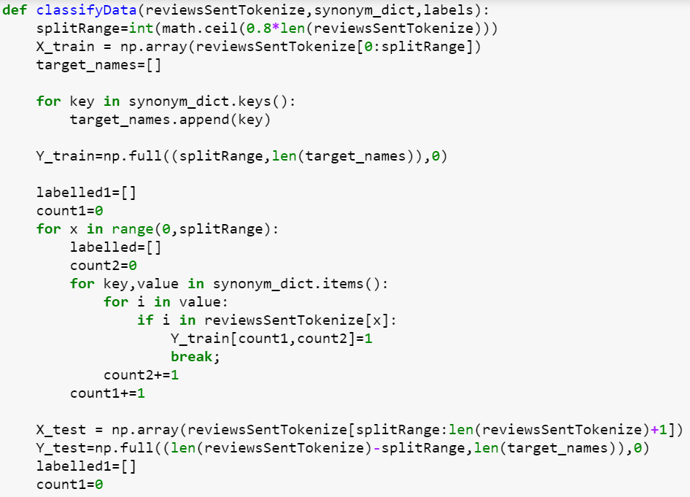
Classification

Slide 14
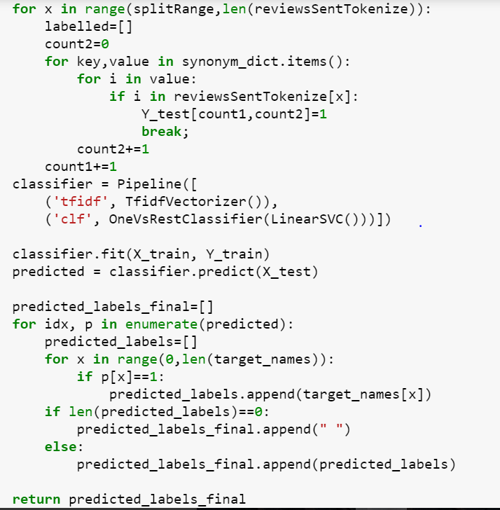
CLASSIFICATION

Slide 15
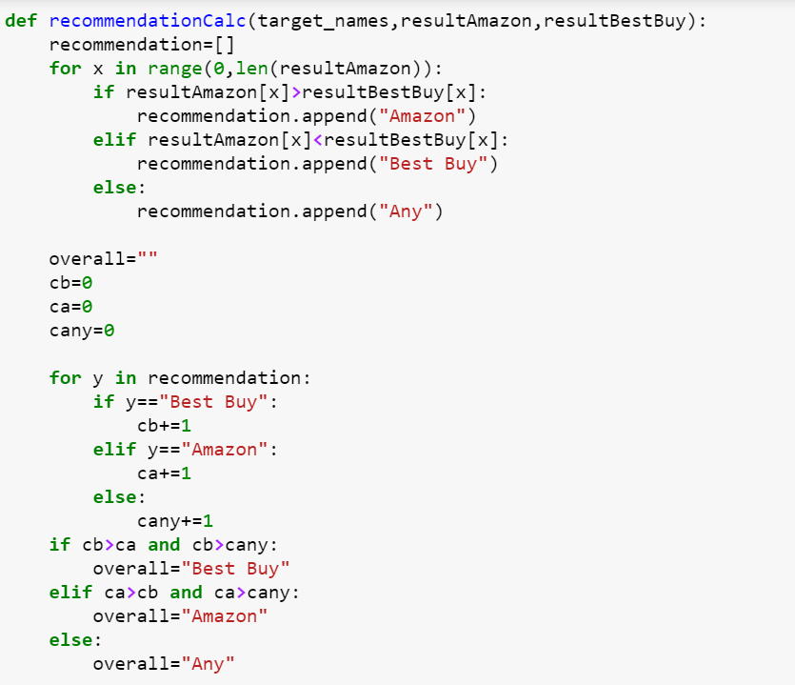
Generating results

Slide 16
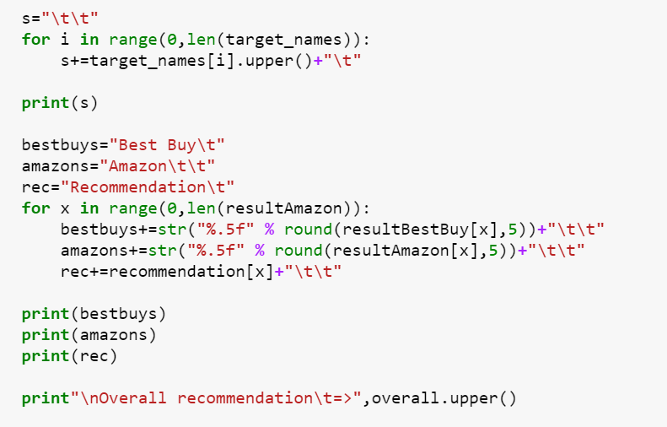
Generating results

Slide 17
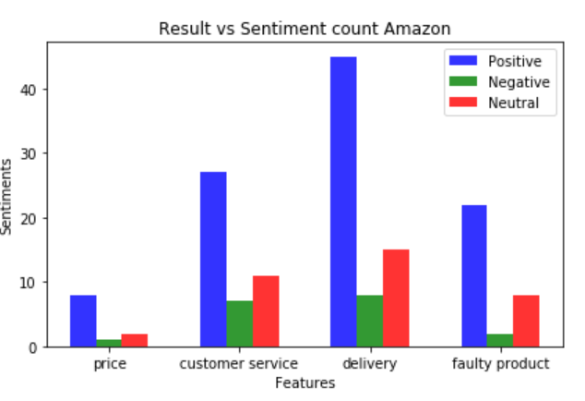
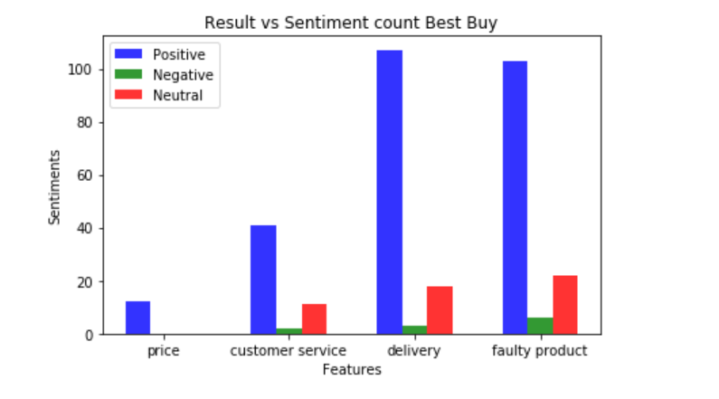
Results

Slide 18
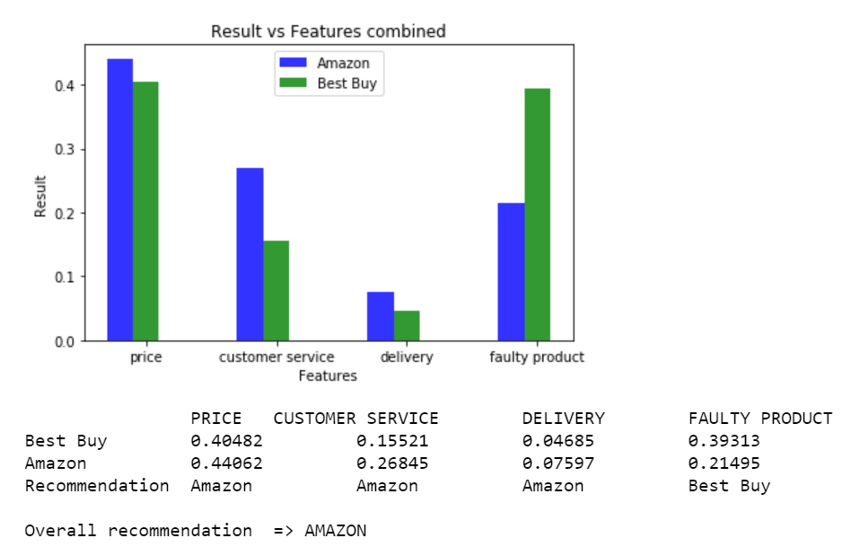
Results

Slide 19
challenges
Scraping of data from web pages:
-Extraction of price
-webpage structure
Prediction of Labels using LDA
Classifying predicted labels:

Slide 20
LIMITATIONS
Number of websites under consideration
Product under consideration
Requirement of GUI

Slide 21
FUTURE SCOPE
Increased website into consideration
Increased products into consideration
Improved UI

Slide 22
THANK YOU !

